Slide 1

DATA ANALYST INTERNSHIP
TASK 2: EMPLOYEE DATA ANALYSIS
By
Aashish Raj

Slide 2
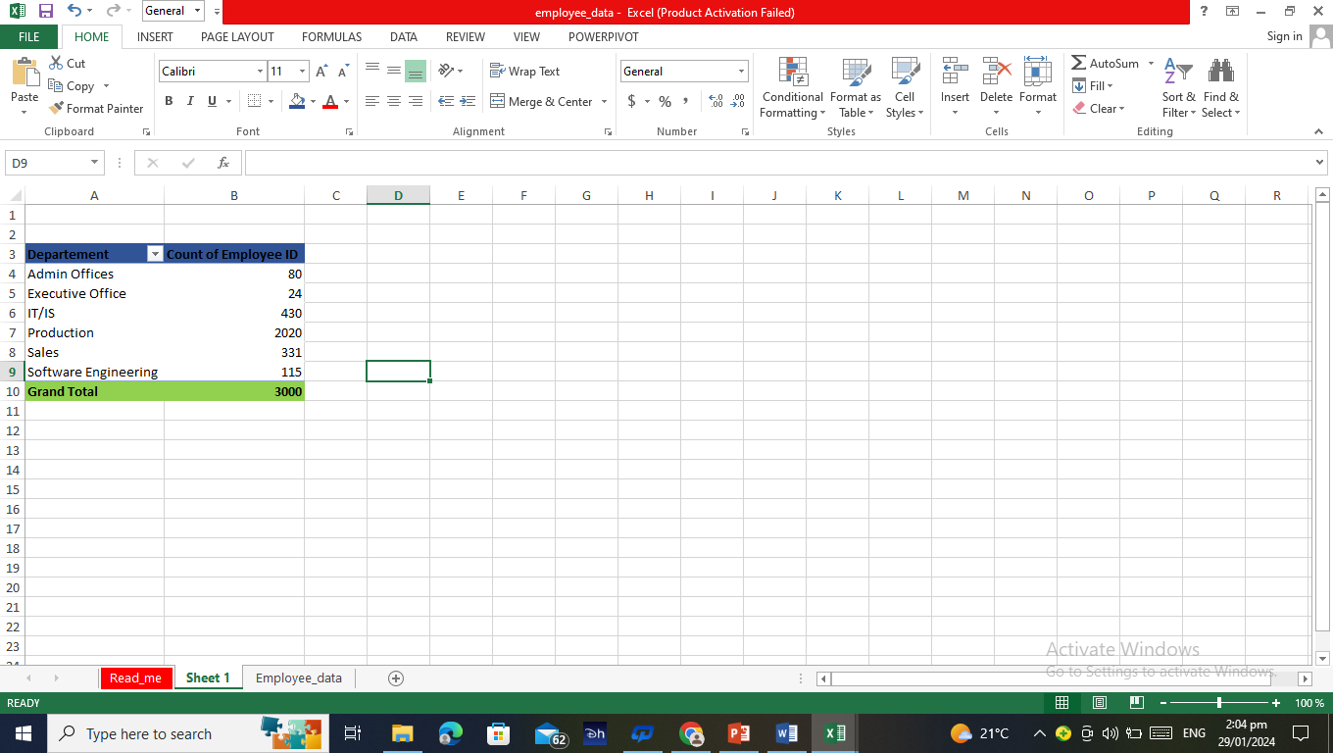
Q1. Can you create a pivot table to summarize the total number of employees in each department?

Slide 3
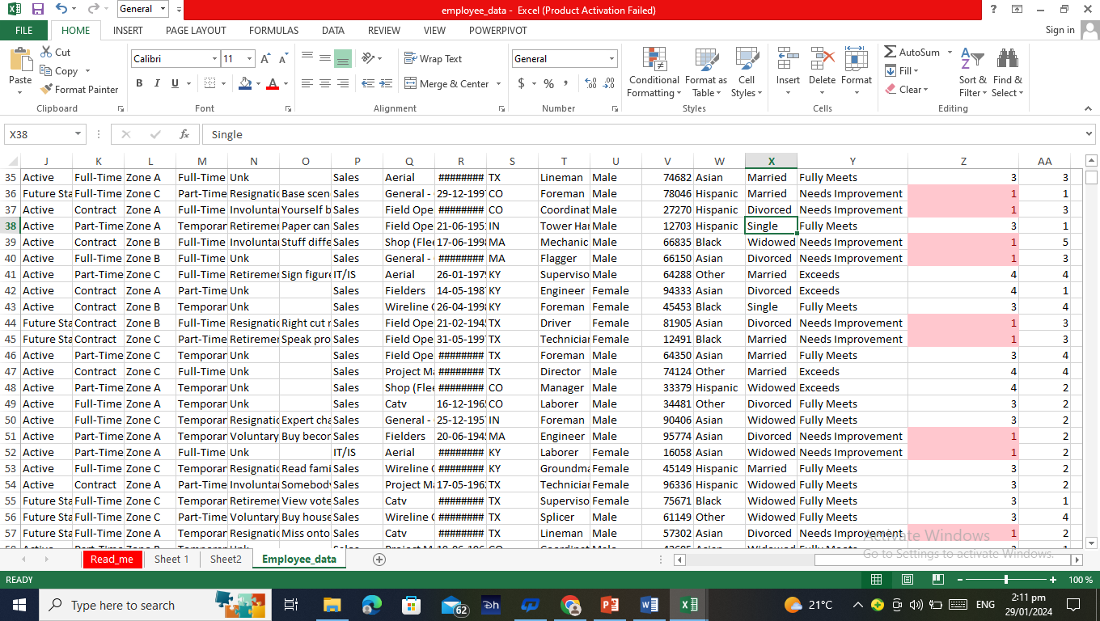
Q2. Apply conditional formatting to highlight employees with a "Performance Score" below 3 in red.

Slide 4
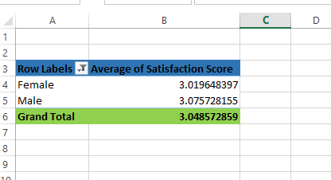
Q3. Calculate the average "Satisfaction Score" for male and female employees separately using a pivot table.

Slide 5
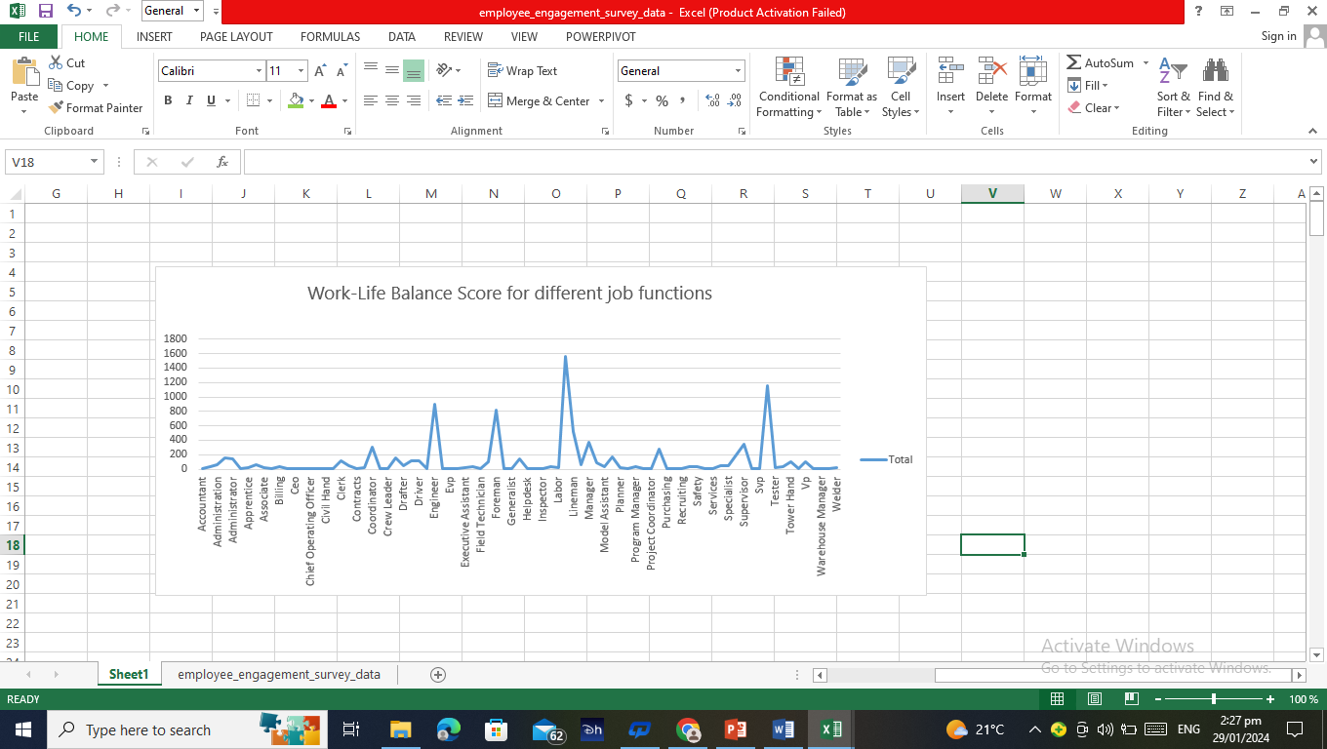
Q4. Create a chart to visualize the distribution of "Work-Life Balance Score" for different job functions.

Slide 6
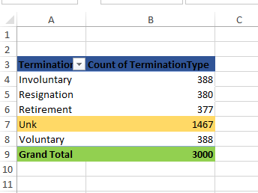
Q5. Filter the data to display only terminated employees and find out the most common "Termination Type."

Slide 7
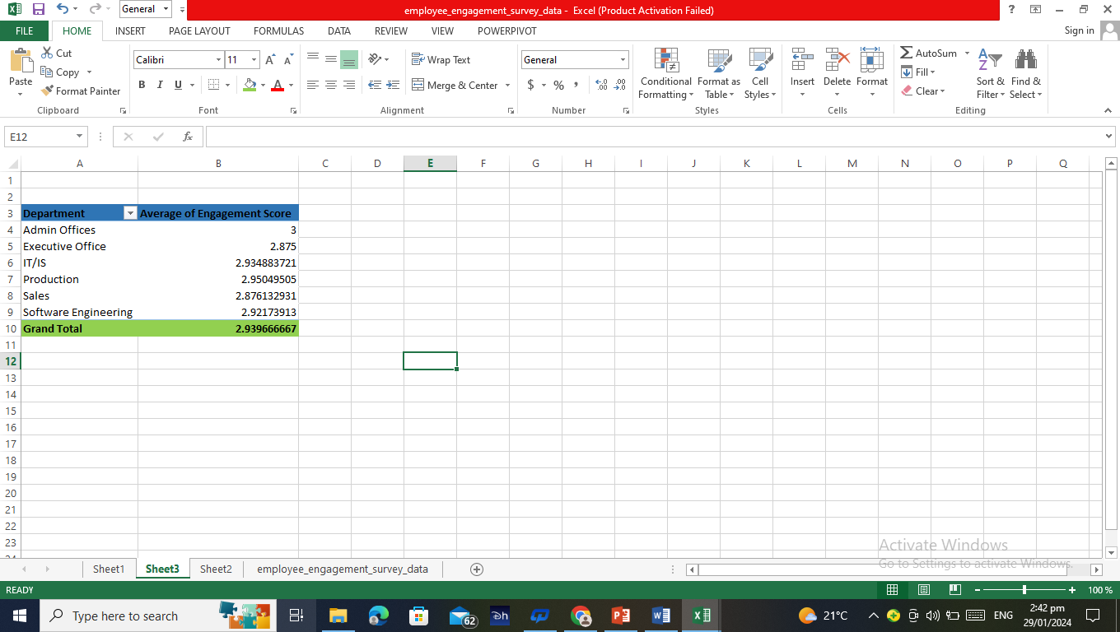
Q6. Calculate the average "Engagement Score" for each department using a pivot table.

Slide 8
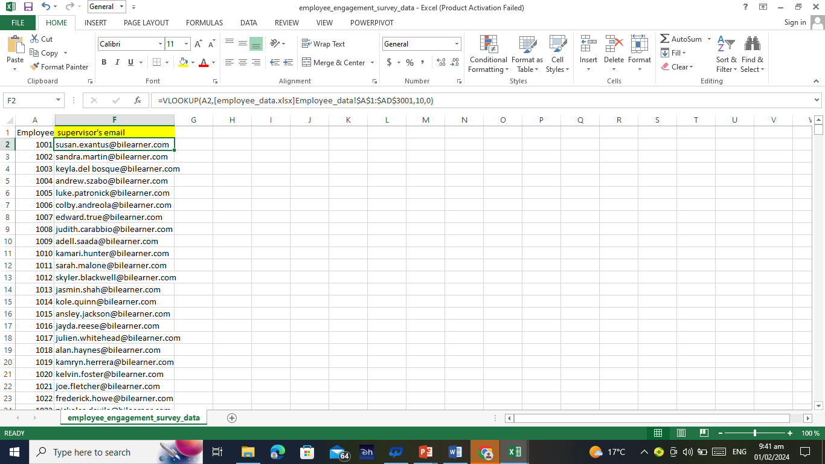
Q7. Use VLOOKUP to find the supervisor's email address for a specific employee.

Slide 9

Q8. Can you identify the department with the highest average "Employee Rating?"

Slide 10
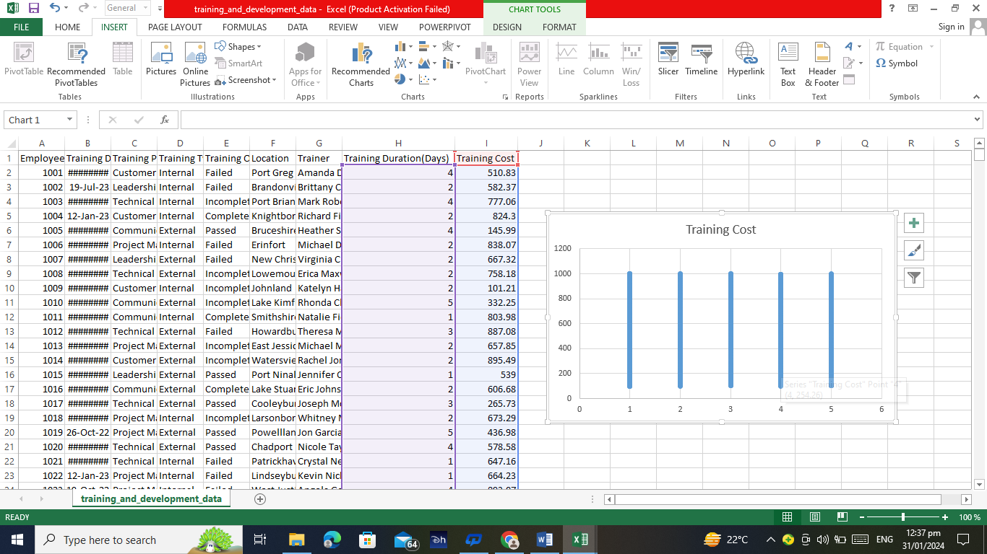
Q9. Create a scatter plot to explore the relationship between "Training Duration (Days)" and "Training Cost."

Slide 11
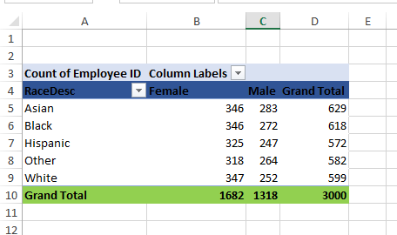
Q10. Build a pivot table that shows the count of employees by "RaceDesc" and "GenderCode“.

Slide 12
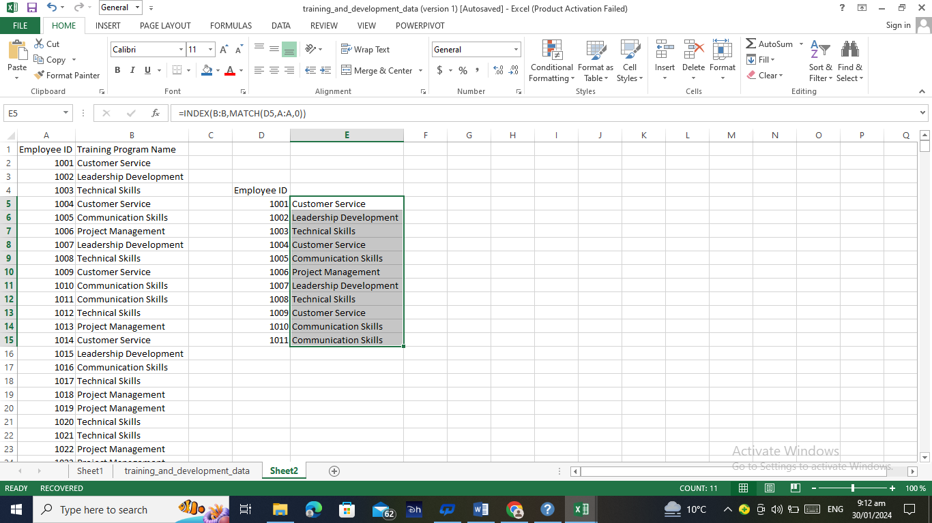
Q11. Use INDEX and MATCH functions to find the "Training Program Name" for an employee with a specific ID.

Slide 13
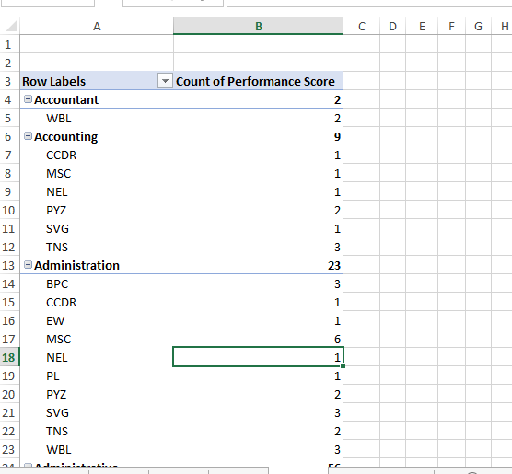
Q12. Create a multi-level pivot table to analyse the "Performance Score" by "BusinessUnit" and "JobFunctionDescription“.

Slide 14
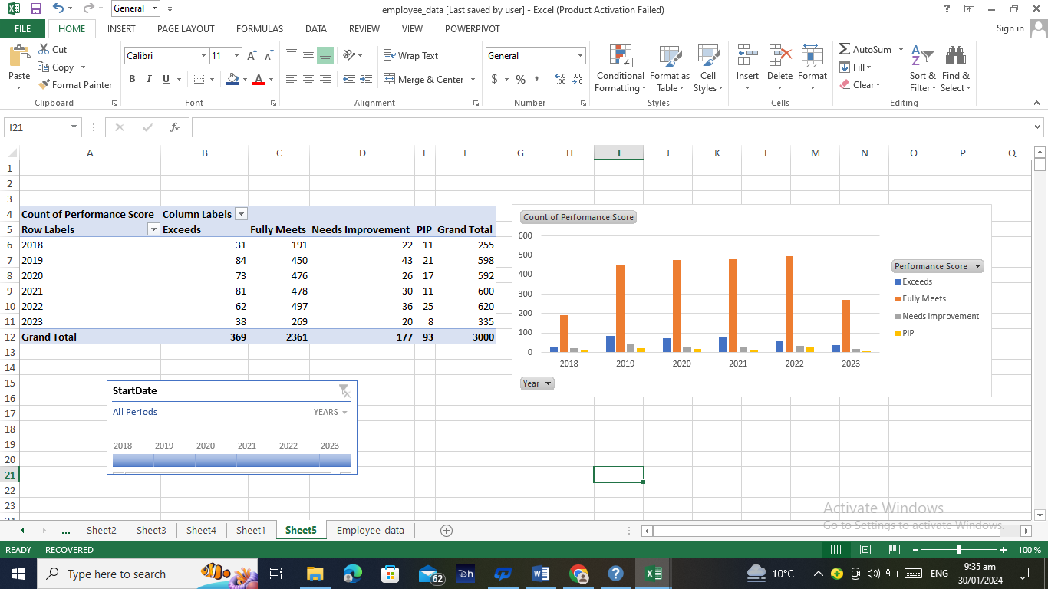
Q13. Design a dynamic chart that allows users to select and visualize the performance of any employee over time.

Slide 15
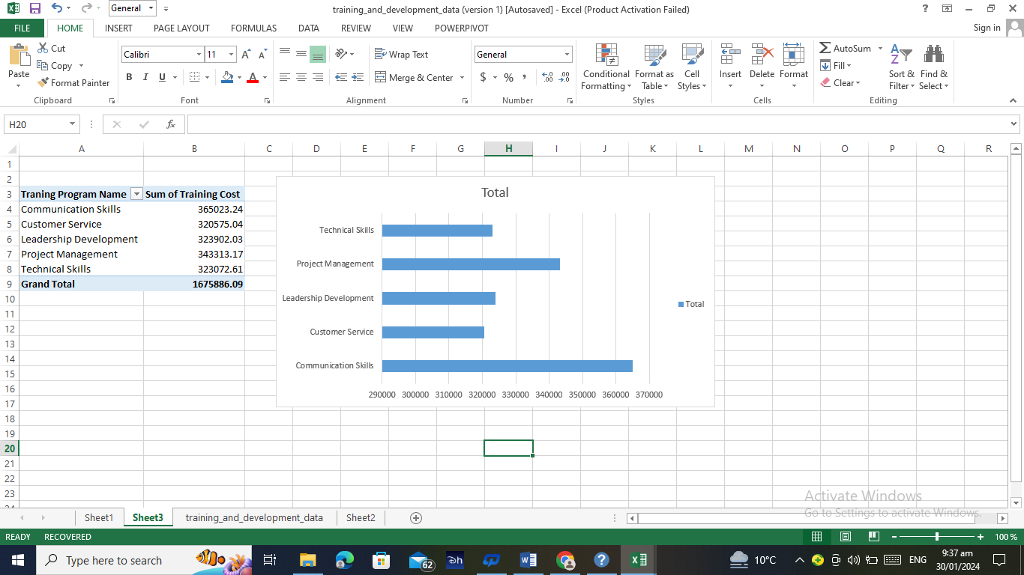
Q14. Design a dynamic chart that allows users to select and visualize the performance of any employee over time.

Slide 16
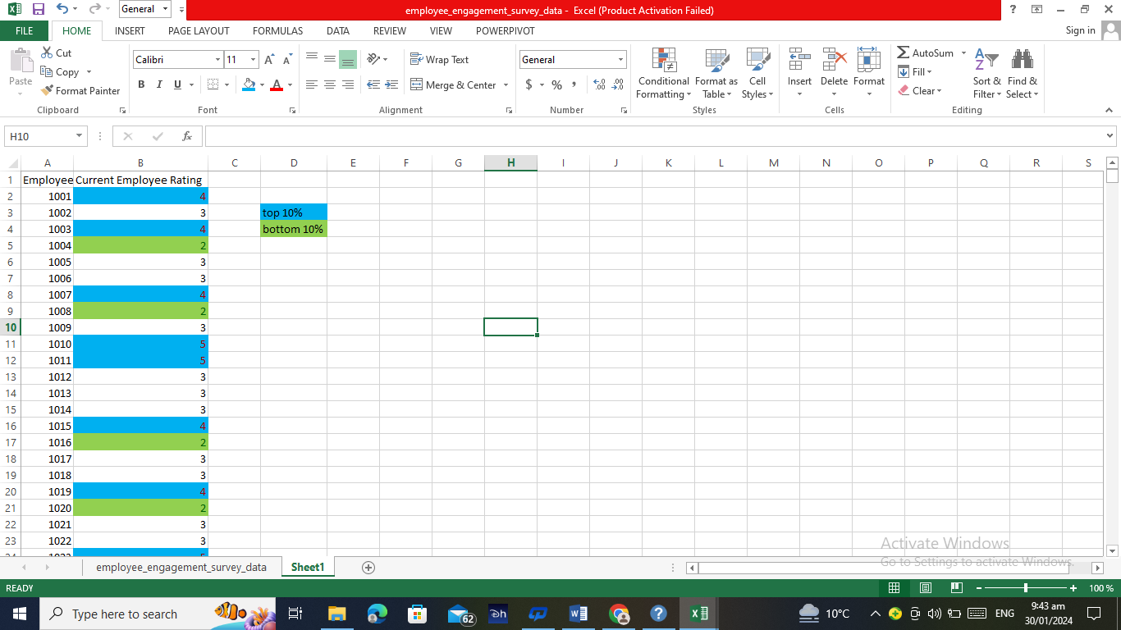
Q15. Apply advanced conditional formatting to highlight the top 10% and bottom 10% of employees based on "Current Employee Rating."

Slide 17
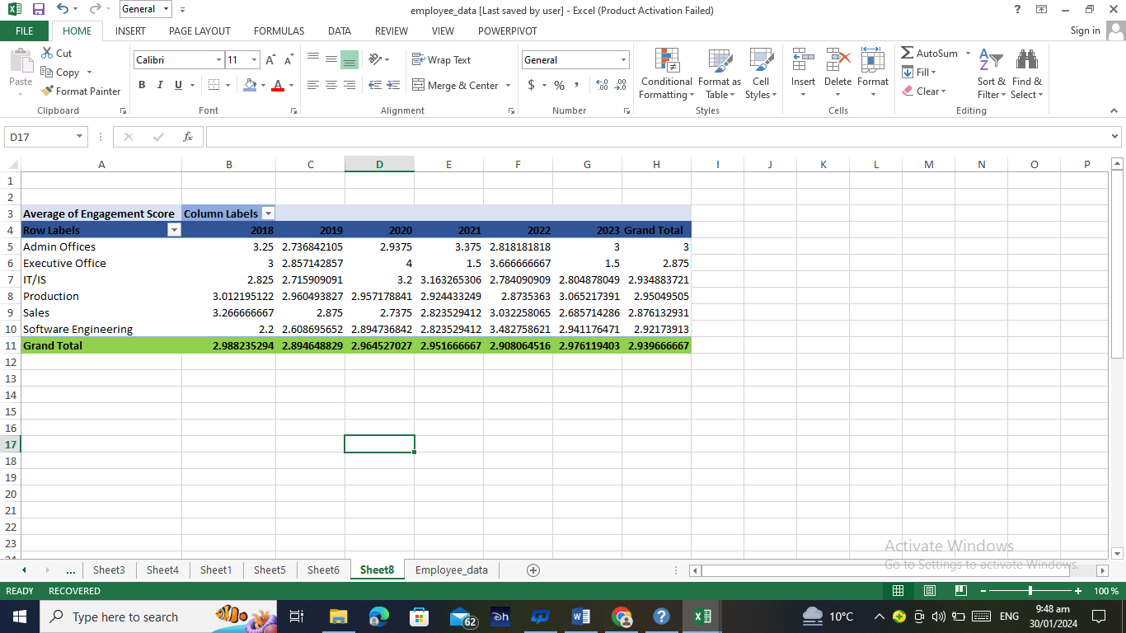
Q16. Use a calculated field in a pivot table to determine the average "Engagement Score" per year.

Slide 18
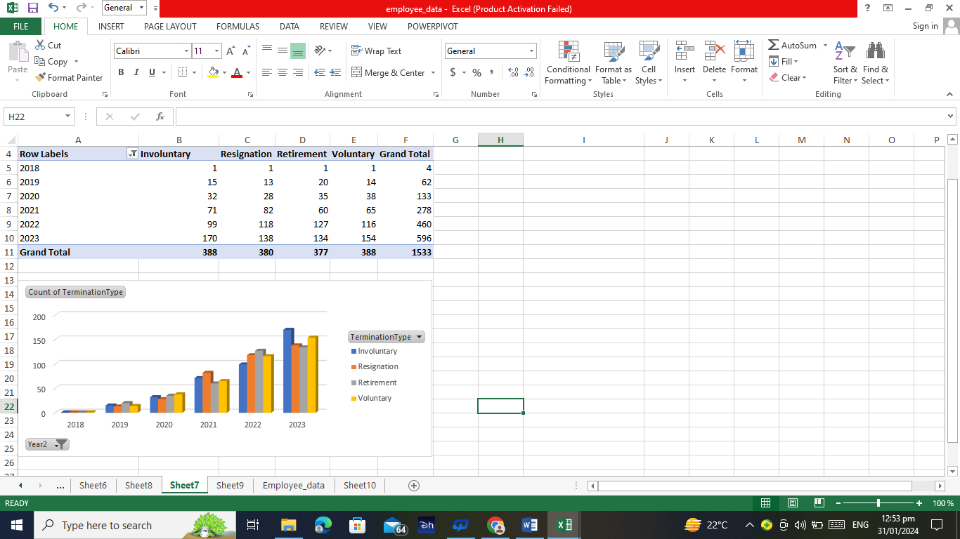
Q17. Create a histogram to understand the distribution of "ExitDate" for terminated employees.

Slide 19
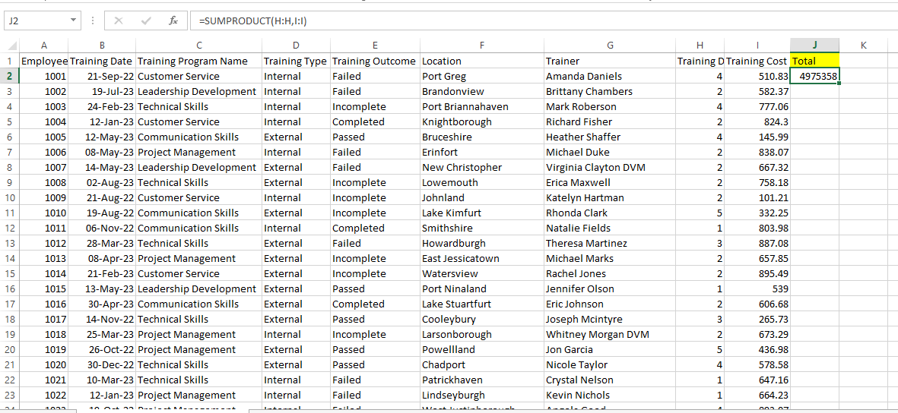
Q18. Utilize the SUMPRODUCT function to calculate the total training cost for employees in a specific location.

Slide 20
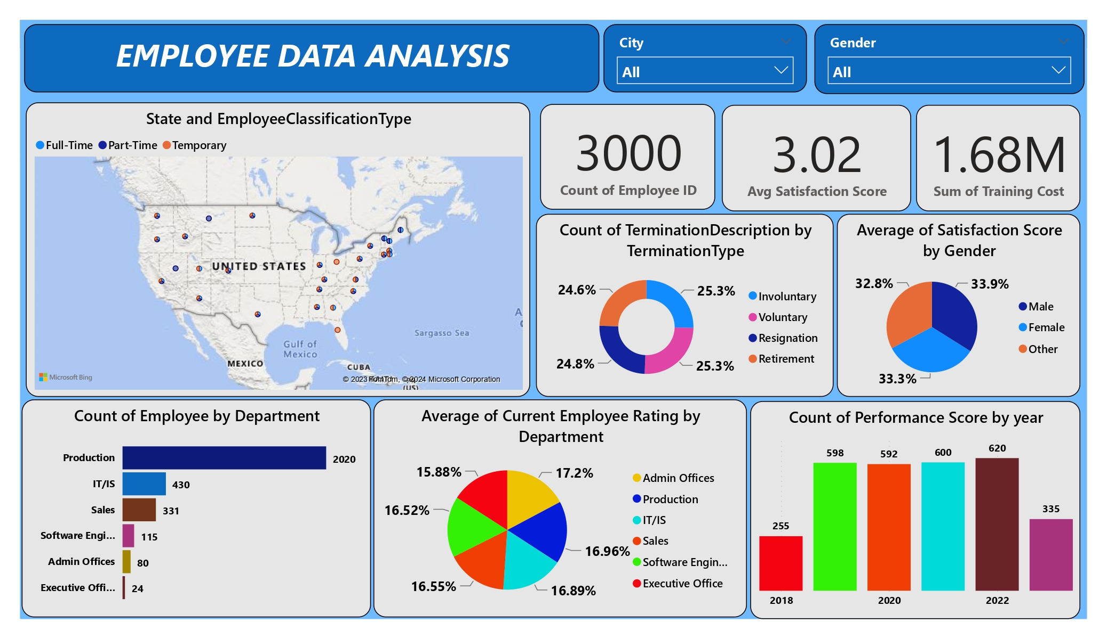
Q19. Develop a dashboard that provides an overview of key HR metrics, including headcount, performance, and training costs, using charts and pivot tables.

